Slide 1


Climate Engineering
Week 10 - Global Climate Change EART21202
Dr Thomas Bannan and Dr Jessica Girdwood

Slide 2


Global Climate Change - 2026
Week 1 – Introduction to climate change and its impacts (5th Feb)
Week 2 – Natural climate variability (12th Feb)
Week 3 – Radiation Law/Greenhouse Effect/Radiative forcing/feedbacks (19th Feb)
Week 4 – Anthropogenic impacts (26th Feb)
Week 5 – The Evidence Base for Climate Change (5th March)
Week 6 – Mid Unit Test (10th March)
Week 7 – Climate Models (19th March)
Week 8 – Climate Change Adaptation (26th March)
Week 9 – Climate Change Mitigation (23rd April)
Week 10 – Climate Engineering (30th April)
Week 11 – Revision Lecture (7th May)
Exam - 18 May 2026, 9:45-11:15
Comments/Questions

Slide 3

Today’s session
  Part 1: Impacts of climate change (10 mins)
  Part 2: Decisions on climate change (20 mins)
  Part 3: Mitigation Strategies (10 mins)
  Part 4: Workshop (50 mins)

Slide 4
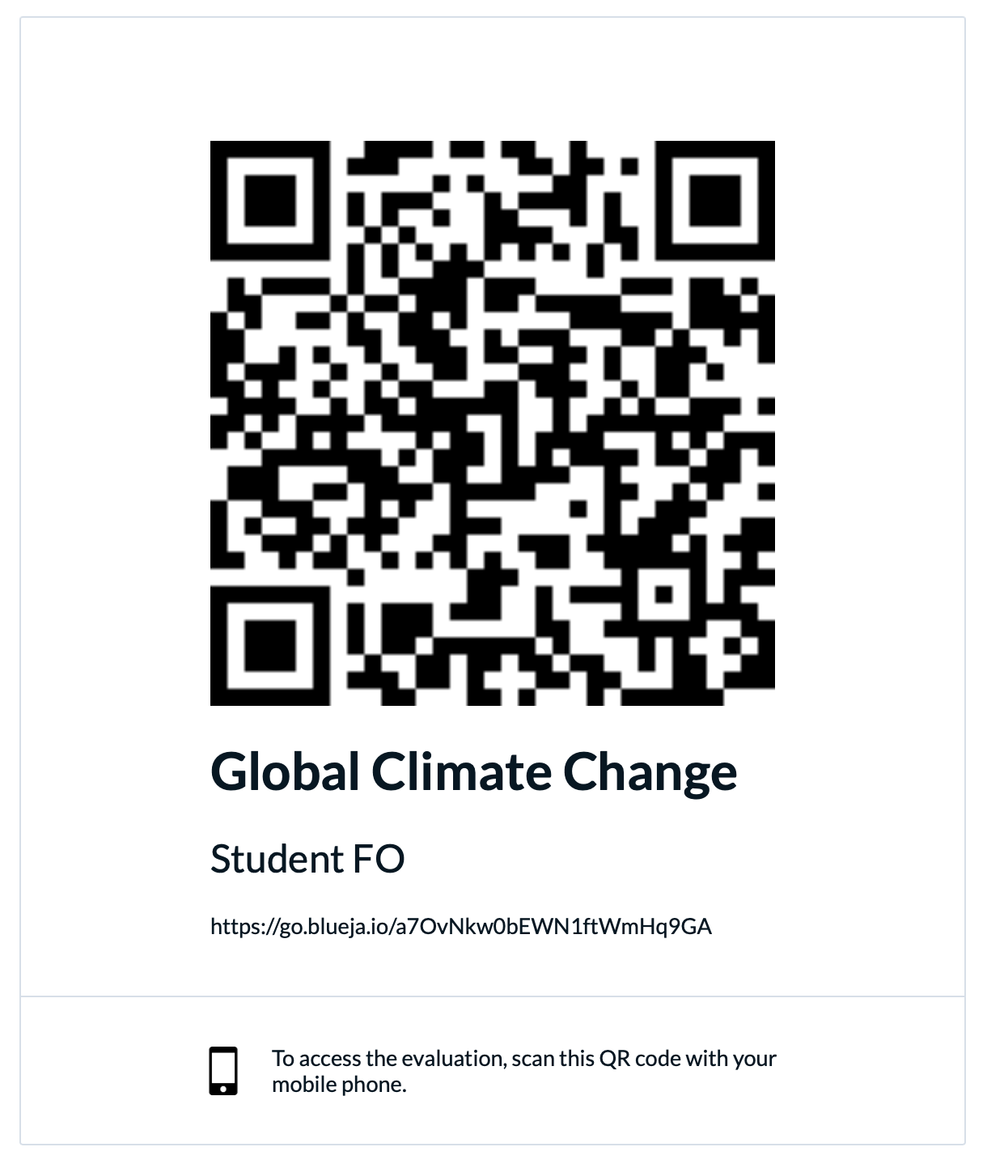
Comments/Questions

Slide 5


In order to deliver on the commitment the UK made by signing the Paris Agreement, the UK has legislated for a net zero emissions target by 2050
The UK Committee on Climate Change (CCC), have made it clear that GGRs will be essential to realising this target, to offset remaining emissions in the sectors where it is most difficult to cut them.

Slide 6
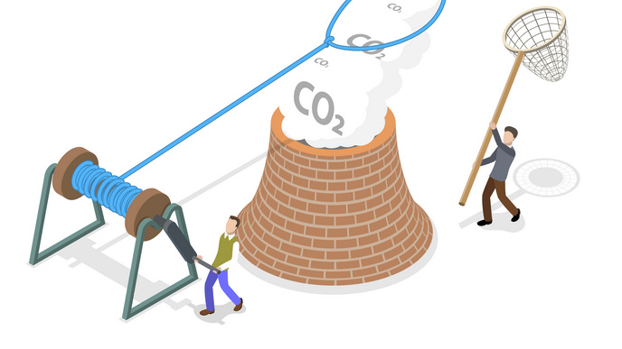
What can we do?

Slide 7

What can we do?
We are already committed to some level of climate change, responding to climate change involves a two-pronged approach:
Adaptation: adapting to life in a changing climate.
The goal is to reduce our risks from the harmful effects of climate change
It also includes making the most of any potential beneficial opportunities associated with climate change (for example, longer growing seasons or increased yields in some regions).
Mitigation: reducing climate change.
involves reducing the flow of greenhouse gases into the atmosphere, either by reducing sources of these gases (for example, the burning of fossil fuels for electricity, heat, or transport) or enhancing the “sinks” that accumulate and store these gases (such as the oceans, forests, and soil).

Slide 8
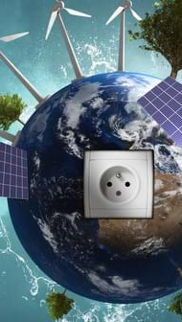
Climate Engineering
Greenhouse Gas Removal (GGR) and Solar Radiation Management (SRM) are terms describing a range of technologies that aim to counteract human-caused climate change
This is done through deliberate large-scale intervention in the Earth’s natural systems.
They are sometimes referred to as ‘geo-engineering’ or ‘climate engineering’.
GGR technologies actively remove greenhouse gases from the atmosphere.
Those that specifically remove carbon dioxide (CO2) from the atmosphere are also known as Carbon Dioxide Removal (CDR) technologies.
SRM technologies reflect some of the Sun’s energy that reaches Earth back into space.
While these would be likely to reduce the Earth’s temperature, they would not reverse ocean acidification (unlike GGRs).

Slide 9
Solar Radiation Modification!
Week 10 - Global Climate Change EART21202
Dr Thomas Bannan and Dr Jessica Girdwood

Slide 10

Runaway Climate Change

Slide 11
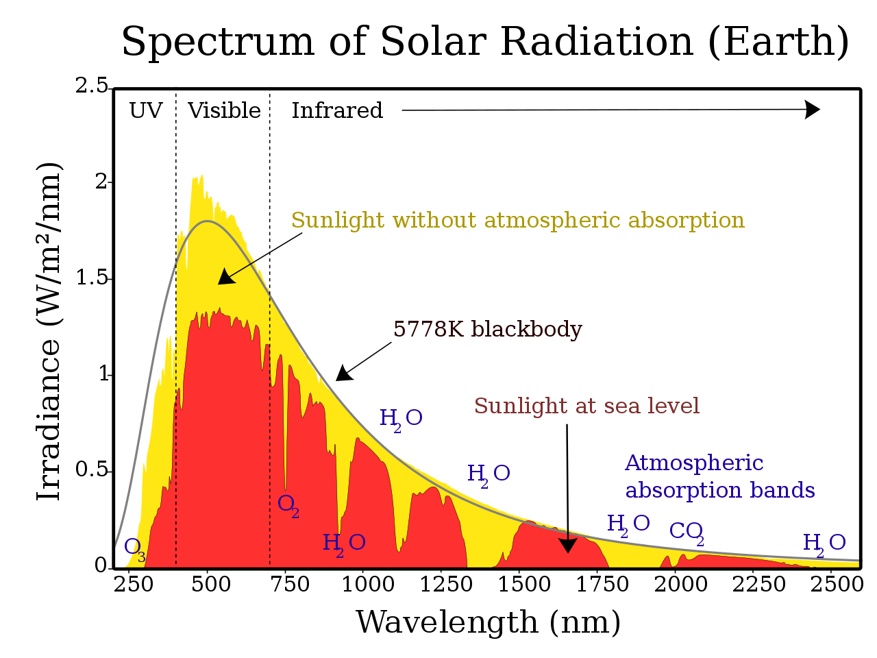
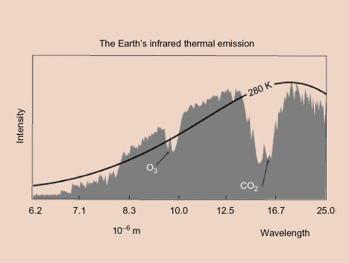
Some EM radiation is reflected by the earth (albedo).
Some EM radiation is absorbed by the earth.
The radiation which is absorbed by the earth is re-transmitted as black-body radiation.

Slide 12
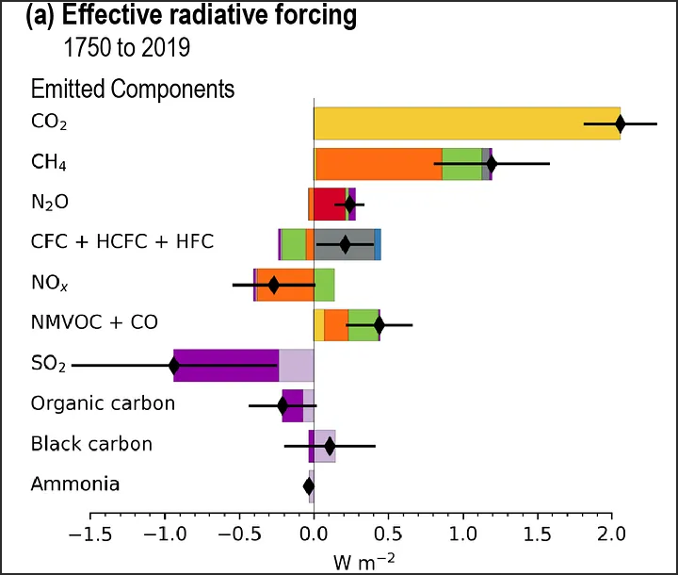
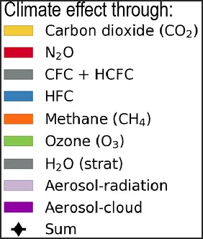
From the IPCC AR6 WG1 report.
Effective radiative forcing is how much heating or cooling power an atmospheric constituent has.
Negative means it cools, positive means it heats.
Colour of the bars coresponds to a constituents interaction with something, described in the key!

Slide 13
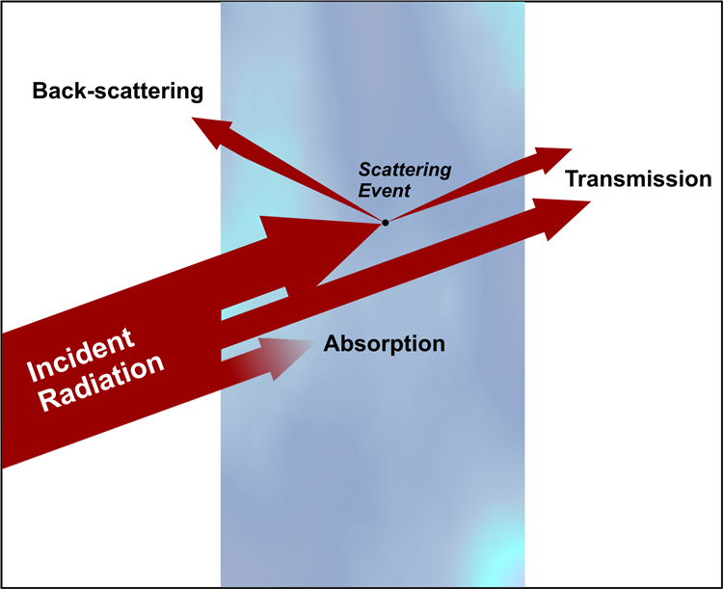
Scattering, Absorbtion, and Extinction
As EM radiation passes though the atmosphere, some is absorbed, and some is scattered.
Scattering is when the light is redirected by reflection, refraction, and diffraction!
There is no change in wavelength with (elastic) scattering, but it can affect radiative forcing by redirecting radiation (think reflecting back into space).
Extinction is the sum of scattering and absorbtion.

Slide 14
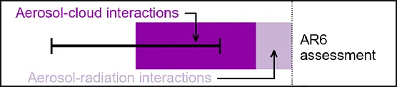
Aerosols and clouds will (generally) cool the planet.
Aerosols will scatter radiation back into space, which is a property called albedo.
Aerosols can also interact with clouds to make them more reflective...

Slide 15
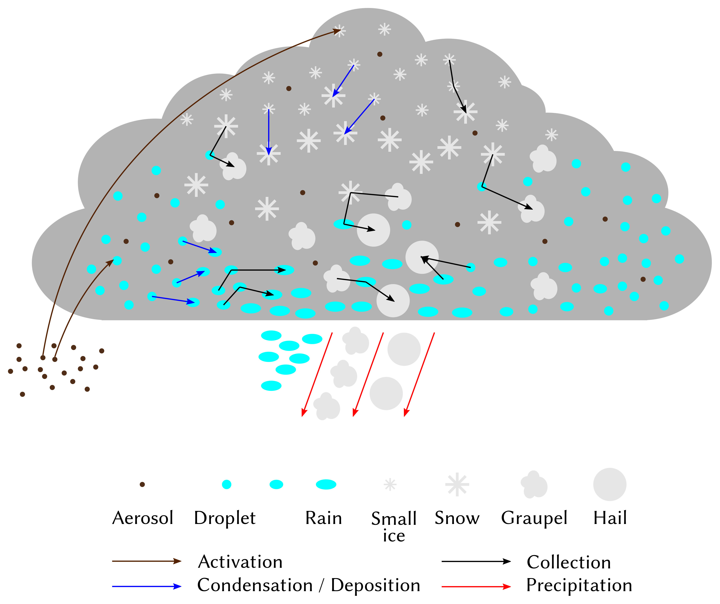
Aerosol acts as a condensation nuclei for droplets.
Clouds are made of droplets and ice crystals of varying sizes.
All cloud particles will scatter light in different ways, depending on their size.
The size of cloud droplets will change depending on how many cloud condensation nuclei there are.

Slide 16
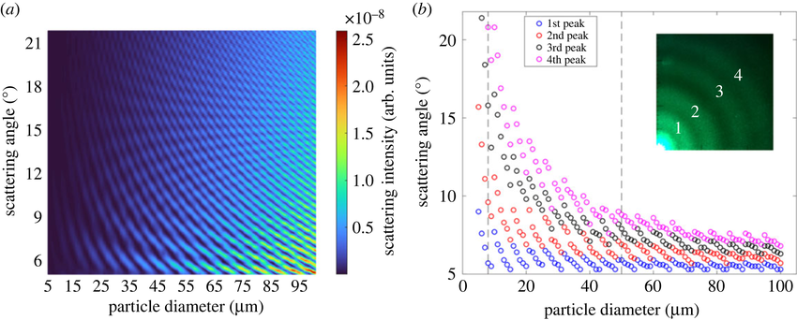
Genc, Sinan & Icoz, Kutay & Erdem, Talha. (2023). Numerical analysis and experimental verification of optical scattering from microplastics. Royal Society Open Science. 10. 10.1098/rsos.230586. ------------------>
90 degrees
0 degrees
Small particles will scatter in all directions, large particles will preferentially forward scatter (transmit).
For further reading, look at how it differs with wavelength!

Slide 17
The bright cloud with small droplets will reflect more EM radiation back into space than it transmits.
The darker cloud with larger droplets will transmit and absorb more radiaiton than it reflects back into space.

Slide 19
Exploiting the Cloud Interaction
Seed new clouds to reflect more sunlight!
Turn darker clouds into brighter clouds by decreasing the size of the droplets!

Slide 20
Cloud droplets form on condensation nuclei
If a parcel of air is super-saturated, then water molecules will start to condense on any surface within that area.
If there is a nucleus for this water vapour, a cloud droplet is formed.
If there is a limit of nuclei, then water vapour will condense on existing water droplets
Water Vapour
Aerosol particle as condensation nuclei

Slide 21
Large number of nuclei means the water vapour is more spread out, which leads to a large number of smaller droplets.
Leads to more reflection of light, as discussed earlier.
Small number of nuclei means all the water vapour is concentrated on a small number of particles.
Leads to a smaller number of bigger drops, which causes more transmission and absorption of light.

Slide 22
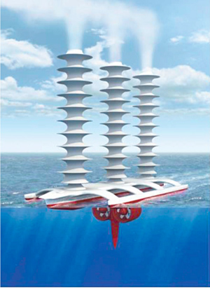
Marine Cloud Brightening
Marine cloud brightening (MCB) exploits this interaction of EM theory with cloud physics in order to modulate the brightness of clouds.
John Latham et al (formerly part of UMIST, merged with UoM) originally proposed this in 1990.
Picture to the right is from his original paper and is an artistic impression of the concept.
The idea is to seed new clouds over the ocean, and increase the bightness of existing ones.
This is done over the ocean because there is lots of water vapour, and marine stratocumulus clouds often contain large droplets with low number concentration. There is also a good source of aerosol in the form of sea salt spray!

Slide 23
Unforeseen Consequences #1!
The potential consequences of MCB are mostly generally that of [SRM] geoengineering generally as opposed to physical and scientific constraints with the methodology. This is because small scale testing can be conducted and quickly stopped if there are issues.
There are issues surrounding the social perception of geoengineering generally.
Modifying the clouds in this way leads to lower precipitation rates, because clouds need the larger droplets to trigger rain. This is less of an issue over the ocean but worth keeping in mind for later!
It is also possible that MCB could be used as an excuse to continue greenhouse gas pollution, and enhance a relliance on the technology.
Should MCB be stopped for any reason, the step change in radiative forcing would be huge and immediate, and likely not give ecosystems any chance for change.
It should be stressed that a reduction in radiative forcing is not exactly equal to a reduction in greenhouse gas emmissions, mearly a mitigation thereof.

Slide 24
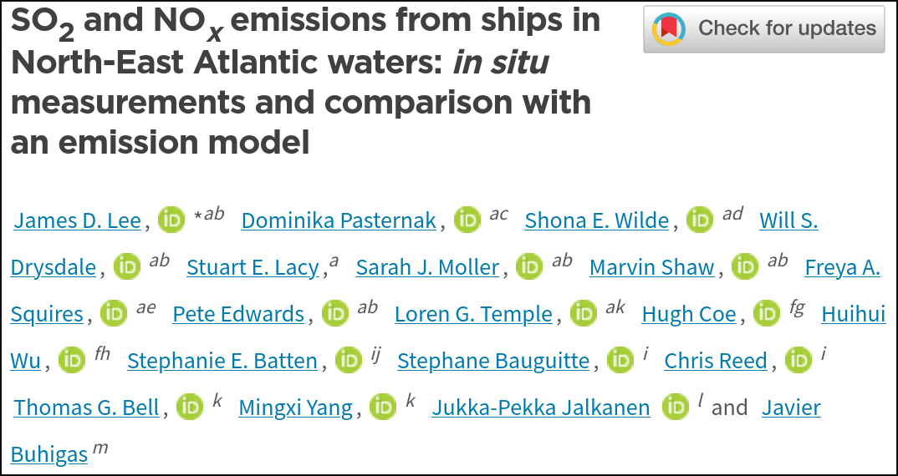
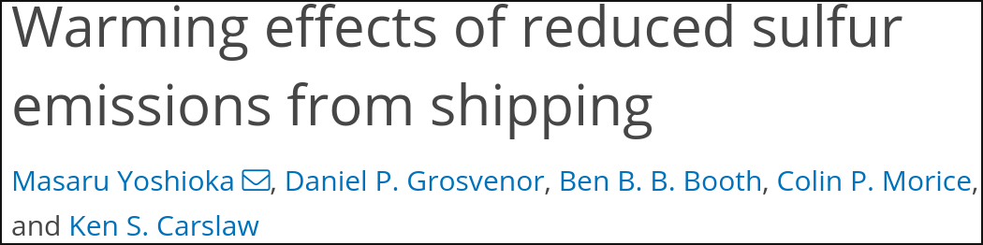
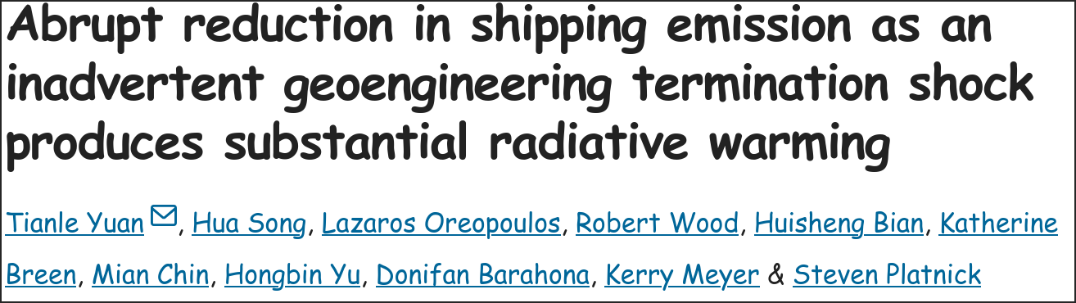

Case Study: Global Shipping
In 2020, fuel regulations abruptly reduced the emission of sulfur dioxide from international shipping by about 80%.
These regulations were put in place because sulphur emmissions are the cause of a large number of deaths per year.
This reversed an accidental SRM geoeingineering effect.
The result of this is a net radiative forcing impact of about +0.2W/m2 (Yuan et al 2024).
There are other reasons why you would want to ban sulphur emmissions (human health impact).

Slide 25
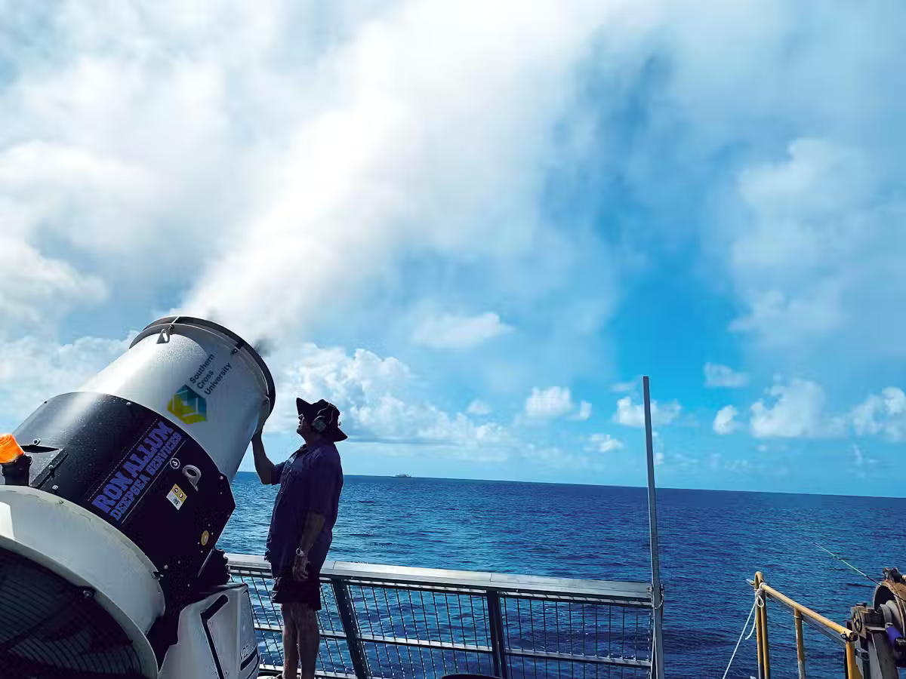
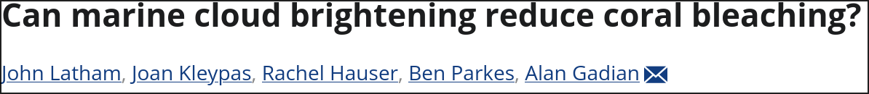
Case Study: Great Barrier Reef Protection
Southern Cross university in Australia have deployed MCB at a small scale to specifically protect the great barrier reef from coral bleaching.
The left image is from https://www.scu.edu.au/news/2023/cloud-brightening-reduces-coral-bleaching/ and shows a test of a spray system.
This is an example of an effective deployment of the technology to solve one specific problem over a small scale.

Slide 26
Case Study: REFLECT project at UoM
This is a project I am involved with at the CAS group at the UoM.
It seeks to better understand Marine Cloud Brightening and better inform its impacts and efficacy
The timeline of the project is:
  A study in the cloud chamber at the UoM
  A model based approach looking at how clouds adapt to aerosol perturbations.
  A social science study of how people will react to MCB, and how public perception of such experiments can be improved
  An indoor test of MCB
  An outdoor deployment of MCB to test it at small scales.

Slide 27
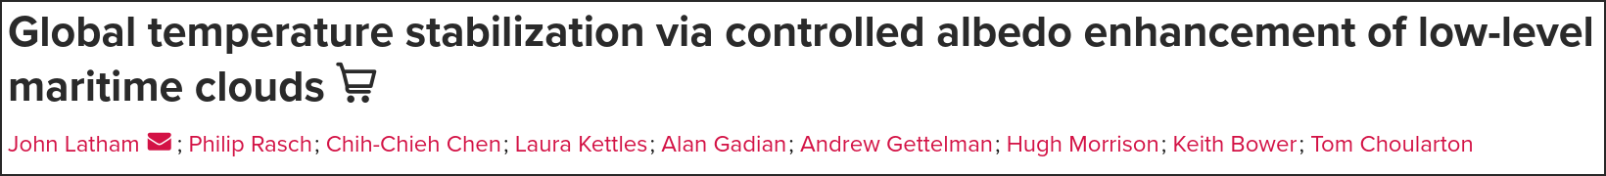
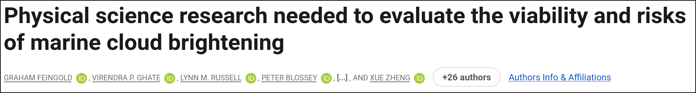
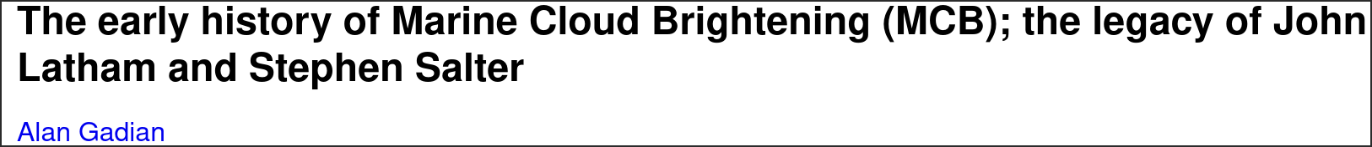

Slide 28
Exploiting the (direct) Aerosol Interaction
Aerosol will directly scatter electromatnetic radiation.
Some of the (downwelling) scattered light gets reflected back into space.
This is what’s called the direct effect of aerosol radiative forcing.

Slide 29
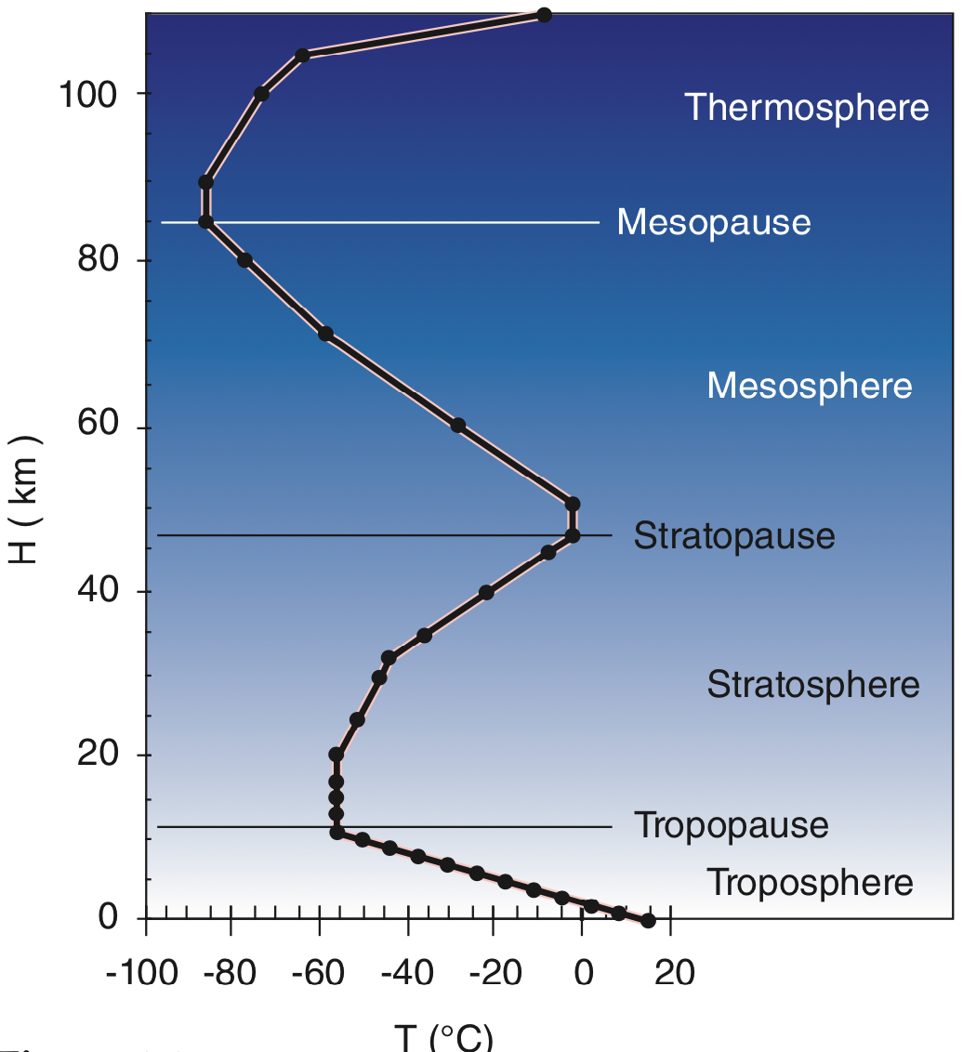
The stratosphere is the region of the atmosphere above the troposphere.
Due to the absorption of em radiation by Ozone, the temperature of the stratosphere increases with altitude.
Inversions will keep aerosol suspended within them since the cold air cannot rise and disperse the aerosol.
Image from https://www.eoas.ubc.ca/courses/atsc113/snow/met_concepts/06-met_concepts/06c-inversions/

Slide 30
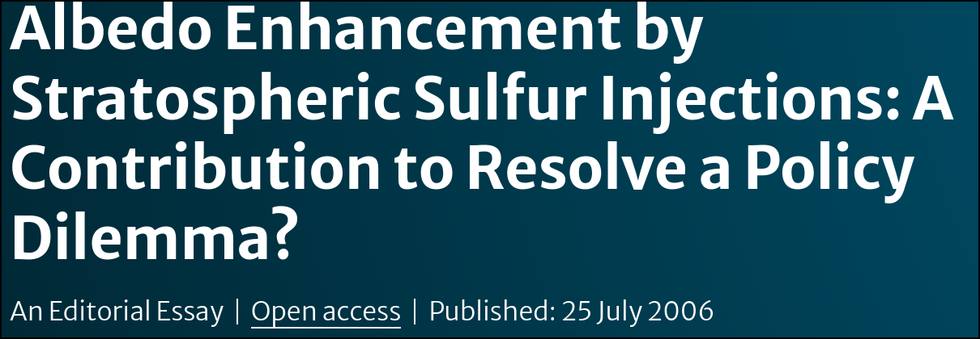
Stratospheric aerosol injection (SAI) is a proposed method whereby aerosol (usually SO2) is dispersed into the stratosphere above the stratospheric inversion.
The origins of SAI are debated but the earliest solid reference is P.J. Crutzen in 2006 https://link.springer.com/article/10.1007/s10584-006-9101-y where it was postulated as a worst-case scenario if GHGs cannot be controlled.
The stratospheric inversion keeps the aerosol suspended within it, keeping the cost of SAI very low.
Compared to MCB, this is far less of an engineering challenge.

Slide 31
Unforeseen Consequences #2!
Unlike with MCB, a lot of the issues with SAI are scientific in nature, in addition to the general issues with [SRM] geoengineering.
SO2 will react with Ozone in the stratosphere and destroy it, potentially leading to a larger hole in the Ozone layer.
The SO2 aerosol will eventually descend from the stratosphere, causing huge human health impact.
SO2 will also interact with clouds and have a brightening effect and resultant rainfall reducation, however this rainfall reduction might not be limited to over the ocean.
Aerosol in the stratosphere could nucleate ice, which would have the opposite effect since ice clouds have positive radiative forcing.
Aerosol above the stratospheric inversion takes a long time (approximately 5 years) to return to the surface, complicating small scale tests and limiting them to lab and model based studies.

Slide 32
Q1.
How can we modify clouds to cool the planet?

Slide 33
Q2.
How can we use aerosol to cool the planet?

Slide 34
Q3.
What are some downsides of geoengineering? Both generally and specific to the two techniques.

Slide 35
Q4.
How can we mitigate the downsides of geoengineering?

Slide 36
Q5.
What social and societal factors need to be considered for geoengineering?

Slide 37
How do we reduce emissions?
Reduce demand for energy
Reduce carbon emissions associated with existing demand
Negative emission technologies
  Increased land uptake of carbon
  Bioenergy with CCS
  Increased ocean uptake of carbon
  Direct air capture and storage
  Storing carbon in the built environment

Slide 38
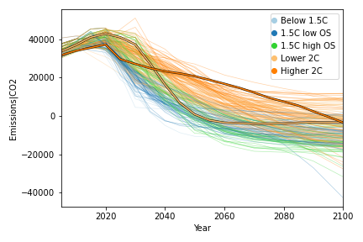
Role of NET’s in Mitigation Policy

Slide 39
Role of NET’s in Mitigation Policy
Need for NETs to:
Offset emissions that cannot be reduced to zero.
Undo the effects of past emissions.
But there are huge risks in thinking they are the solution:
Never implemented at scale.
Research or deployment of NETs can delay or deter action to reduce GHG emissions.
Use of ‘net zero’ as a target often hides excessive reliance on NETs.
Promises of future carbon removal later instead of reducing emissions now are essentially a huge gamble with future generations paying the cost

Slide 40

Forests and better management
Notes:
The first method I want to talk about is growing forests and woodlands. This is perhaps the simplest of the removal methods.
When trees grow they naturally absorb carbon dioxide from the atmosphere.
It takes a forest about 10 years to ramp up to absorbing the maximum amount of carbon it can
And after 20-100 years the forest reaches what we call maturity, and the amount of carbon it can absorb starts to slow down
We can grow more forests and woodlands – and we can manage our forests better.
e.g. there are ways to remove some tree growth to make room for other trees to grow more successfully. This allows you to increase the overall amount of carbon that can be stored in that forest

Slide 41
Forests and better management
Potential advantages | Potential disadvantages
Costs are relatively low Potential to store carbon is well known and understood Could store significant amount of carbon dioxide | It takes time for trees to mature (at least 10 years) Uses land that could be used for other activities Could have a negative impact on biodiversity

Slide 42
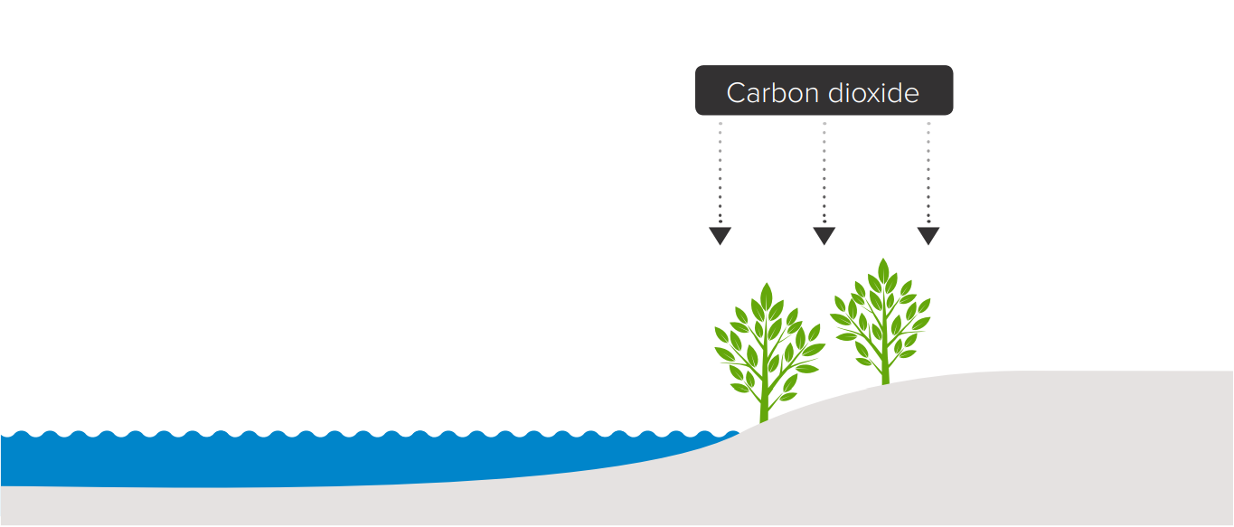
Peatlands and wetlands
Potential advantages | Potential disadvantages
We know how to restore peatlands and wetlands A quick way to store carbon at relatively low cost Could have other economic environmental benefits | Understand less about the science of storing carbon in these places for a long time Uses land that could be used for something else Limited potential: only some areas of the UK are suitable
Notes:
The second method I want to talk about is peatlands and wetlands. Like forests this is another natural way of doing greenhouse gas removals.
Peatlands and wetlands are the damp, wet natural habits that we find all around the UK. These habits naturally absorb a lot of carbon. But if they dry out then they release that carbon back into the atmosphere.
What that means is that if we want to use these habitats as a way of removing greenhouse gases from the atmosphere then we need to keep them wet. Often that means restoring these peatlands and wetlands because agricultural practices have deliberately dried them out over time to create farmland.

Slide 43
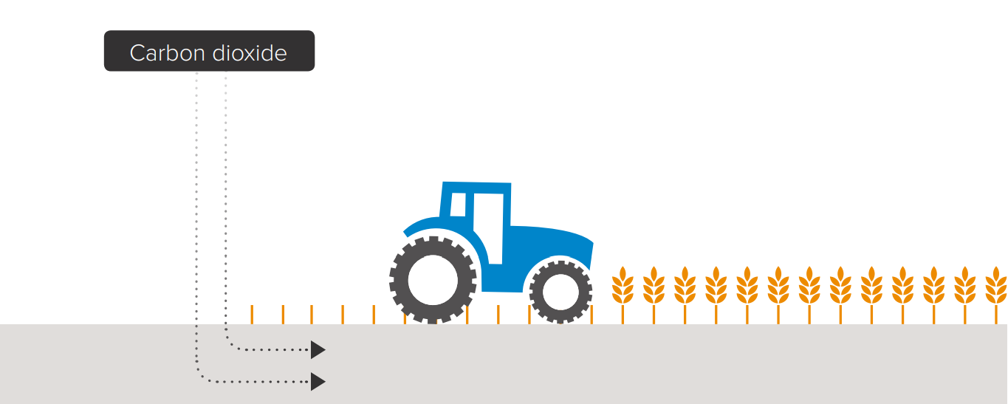
Enhancing the storage of carbon in soil
Potential advantages | Potential disadvantages
Well-understood method that can be implemented now Could have a low cost Could have other economic and environmental benefits | Requires changes to modern farming practices Farmers may need financial support from government Could reduce amount of food that can be produced
Notes:
The next method I’m going to talk about is enhancing the storage of carbon in the soil.
Again, like with forests, peatlands and wetlands, the soil naturally stores carbon.
How much carbon the soil can store is affected by:
How often we disturb the soil (e.g. how often we plough it with machines)
How much organic material is in the soil. Organic material is things that were living, like plants, that are now dead. So those of you who have gardens may have a compost heap where you put garden waste (hedge trimmings etc). You let that decay a bit and then you dig that back into the soil. That’s organic material.
If we want the soil to be able to store more carbon, we need to disturb it less and it ensure it has more organic materials in it. This is really about changing farming practices:
Changing ways that crops are grown
Reducing how often we plough the soil with machines
Using natural fertilizers rather than artificial ones
Moving on to slide 7

Slide 44

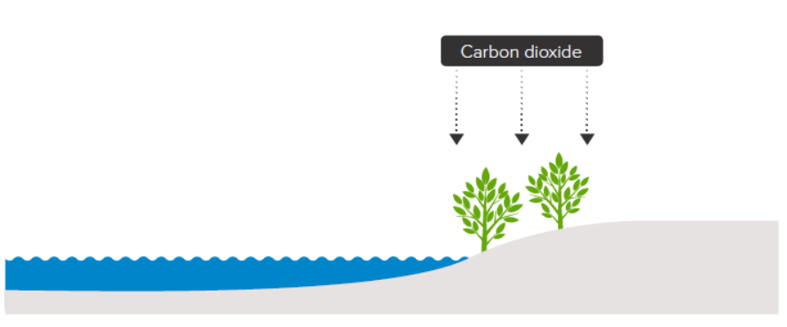
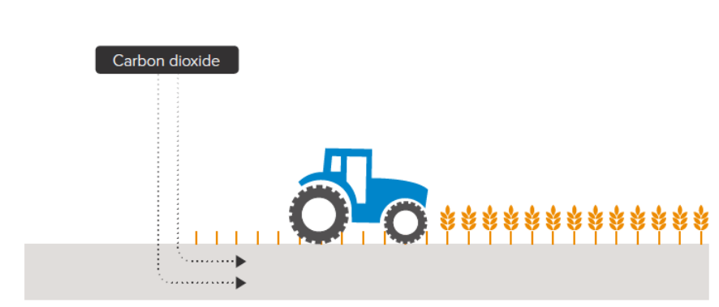
Increasing Land Uptake of Carbon
The land surface uptakes carbon in many ways
Afforestation and reforestation
✓ Improved soil quality
Land availability
Biodiversity loss
Wetland and peatland restoration (high carbon density)
✓ Benefits water quality, flood protection, biodiversity
✗ Potential methane source
Soil carbon sequestration
Improved crop yields and soil fertility
✗ Nitrous oxide release

Slide 45
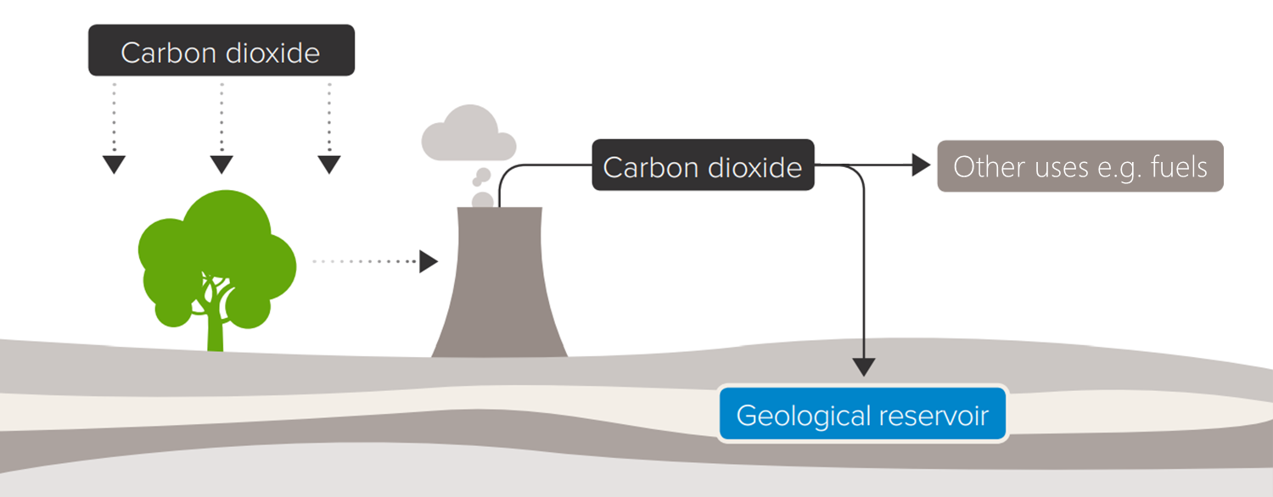
Bioenergy with carbon capture and storage

Slide 46
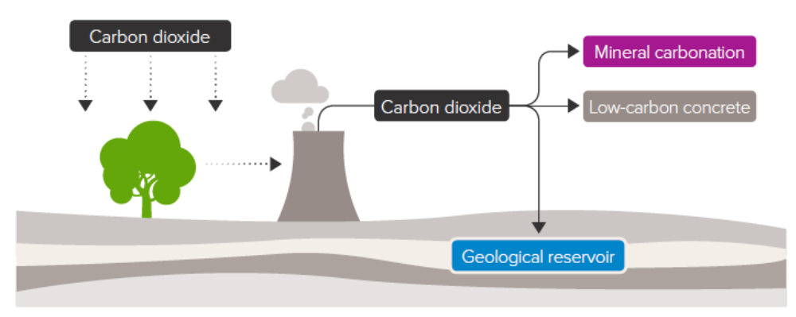
Bioenergy with carbon capture and storage

Slide 47
Bioenergy with carbon capture and storage
Potential advantages | Potential disadvantages
Could capture and store a significant amount of carbon dioxide emissions Combines technologies that are well understood Lots of storage space in the UK (e.g. oil and gas fields) | Likely to have high costs, at least initially Uses land that could be used for other activities Need to ensure that carbon dioxide storage is secure

Slide 48
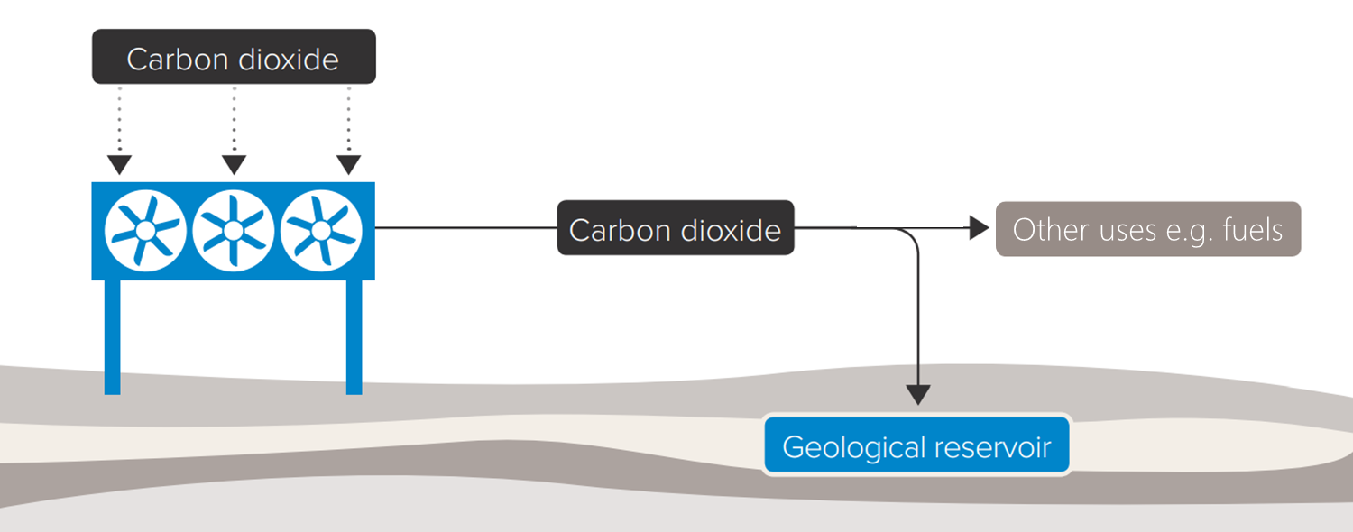
Direct air capture and carbon storage
Potential advantages | Potential disadvantages
Could capture and store a significant amount of carbon dioxide emissions Lots of storage space in the UK (e.g. oil and gas fields) A variety of technical options are being developed | Technologies are very new and experimental Could require a large amount of low carbon electricity Current costs are very high, though they could fall as technology improves

Slide 49
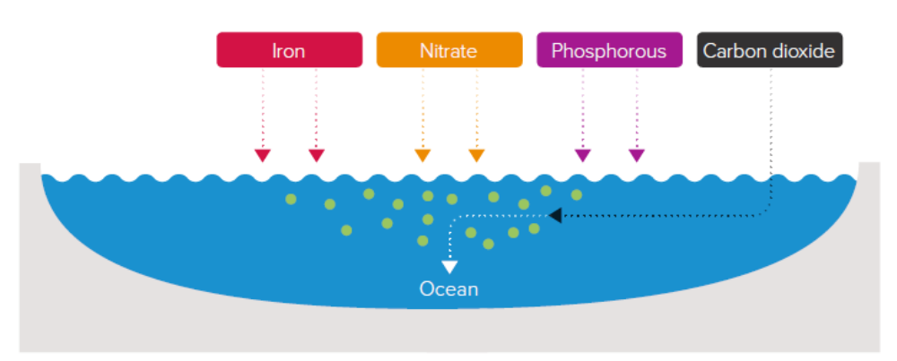
Increasing Ocean Uptake of Carbon
Ocean fertilization
Simple technology and not particularly costly
Unknown impacts on fisheries or marine ecosystems
Some algal blooms can be toxic to humans.
Potentially high energy cost of producing the minerals

Slide 50
Increasing Ocean Uptake of Carbon
Ocean fertilization
Simple technology and not particularly costly
Unknown impacts on fisheries or marine ecosystems
Some algal blooms can be toxic to humans.
Potentially high energy cost of producing the minerals

Slide 51
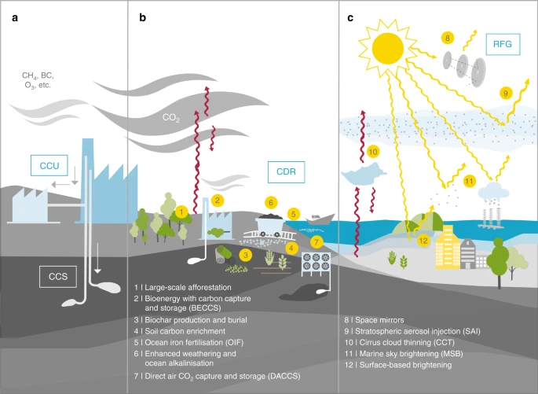
Example NET
Afforestation Bioenergy with carbon capture
Biochar production and burial
Soil carbon enrichment
Ocean iron fertilisation (OIF)
Enhanced weathering and ocean alkalinisation
Space mirrors
Stratospheric aerosol injection (SAI)
Cirrus cloud thinning (CCT)
Marine sky brightening (MSB)
Surface-based brightening
Direct air CO₂ capture and storage (DACCS)
Lawrence et al., 2018, Nature Communications

Slide 52
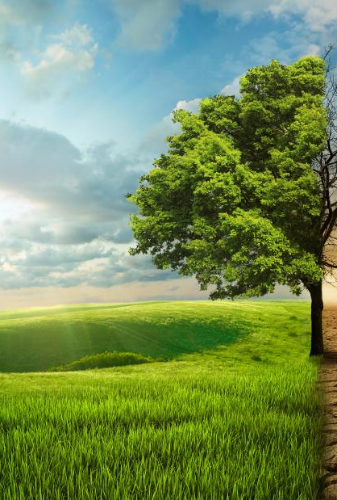
Lecture Summary
Climate engineering involves large-scale interventions to counter climate change.
Two main approaches:
GGR/CDR: removes CO₂ (addresses root cause)
SRM: reflects sunlight to cool the planet (does not reduce CO₂)
Techniques like MCB and SAI can lower temperatures by increasing albedo, but come with major uncertainties.
Key issues:
Environmental risks
Termination shock
Ethical and governance challenges
Climate engineering may help limit warming, but cannot replace emissions reductions.
Mitigation must remain the priority, with climate engineering only as a potential supplement.

Slide 53


Thank you
Thomas.Bannan@Manchester.ac.uk
Notes:
Post-training evaluation survey

Slide 54
Comments/Questions

Slide 55
Q1.
Is it more effective to prioritise immediate emissions reductions or invest heavily in future technologies like carbon removal? Why?

Slide 56
Q2.
Should Solar Radiation Management (SRM) technologies be researched or deployed, even though they do not address root causes like CO₂ emissions or ocean acidification?

Slide 57
Q3.
Which NETs (e.g. afforestation, BECCS, DACCS) do you think are most viable for large-scale deployment in the UK, and why?

Slide 58
Q4.
Should governments invest heavily in NET development now, despite high costs and uncertainty, or wait until technologies mature?

